Slide 1
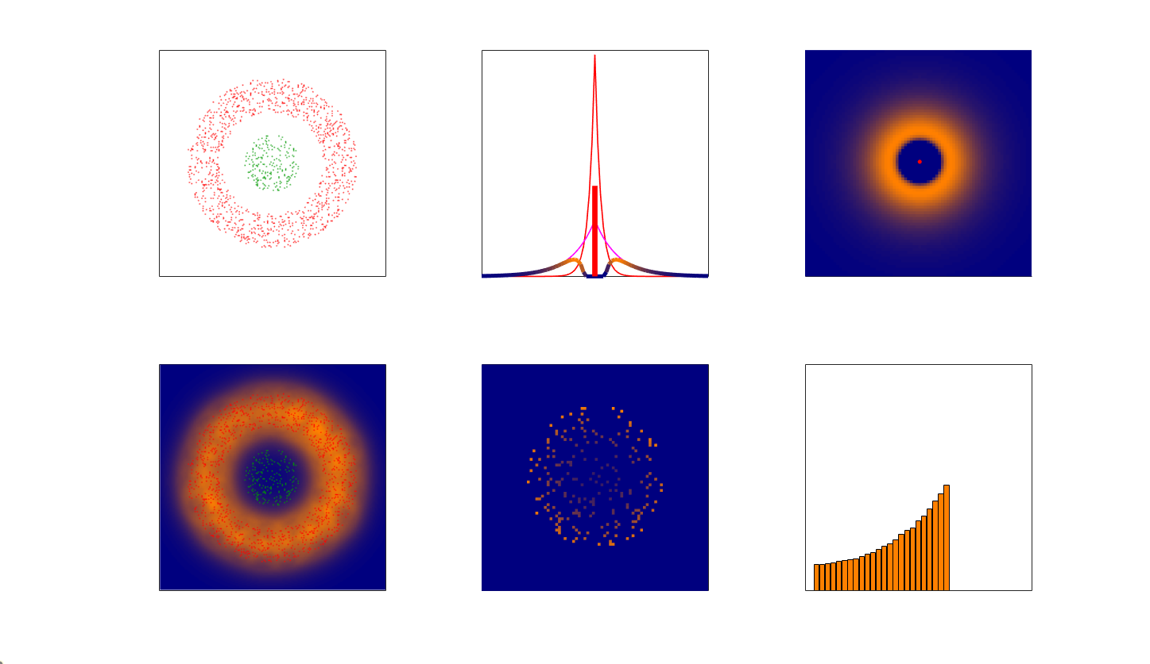
Fig. S7 - Model 3 – TCR phosphorylation (TP) – output data
A
Points pattern
B
1D probability distribution
C
2D probability distributions
3000
CD45
TCR
CD45
Lck*
Combined
400
CD45
0.2
y(nm)
y(nm)
y(nm)
2000
0.1
0
1000
0
-400
1000
2000
3000
-400
0
400
-400
0
400
D
x(nm)
E
x(nm)
F
x(nm)
3000
Points pattern with Prob. distr.
TCR phos. probability
Radial distributions of TCR*
CD45
TCR
2400
0.2
TCR*
y(nm)
y(nm)
y(nm)
2000
2000
0.1
1000
1600
0
1000
2000
3000
1600
2000
2400
0
200
400
x(nm)
x(nm)
r(nm)

Slide 2
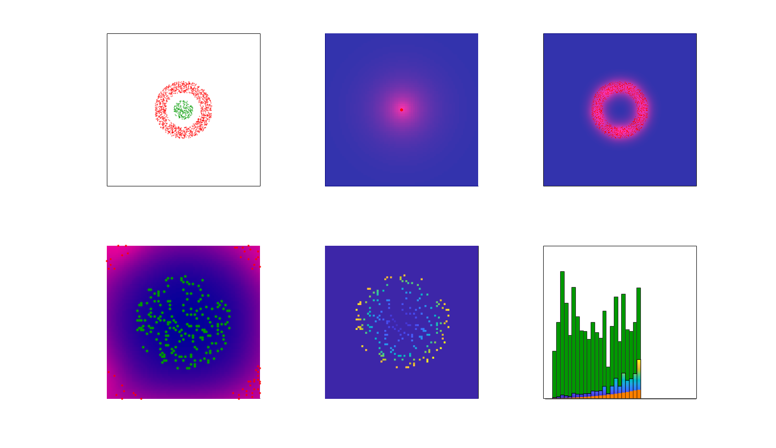
Fig. S7 - Model 3 – TCR phosphorylation (TP) – output data
A
Points pattern
B
One Lck* probability distribution
C
Sum of Lck* probability distributions
4000
CD45
TCR
400
CD45
4000
CD45
y(nm)
y(nm)
y(nm)
2000
0
2000
0
-400
0
0
2000
4000
-400
0
400
0
2000
4000
D
x(nm)
E
x(nm)
F
x(nm)
2400
TCR locations
TCR* probability
Radial distributions
CD45
TCR
2400
0.2
TCR
pTCR
rTCR
y(nm)
y(nm)
y(nm)
2000
2000
0.1
1600
1600
0
1600
2000
2400
1600
2000
4000
0
200
400
x(nm)
x(nm)
r(nm)

Slide 3
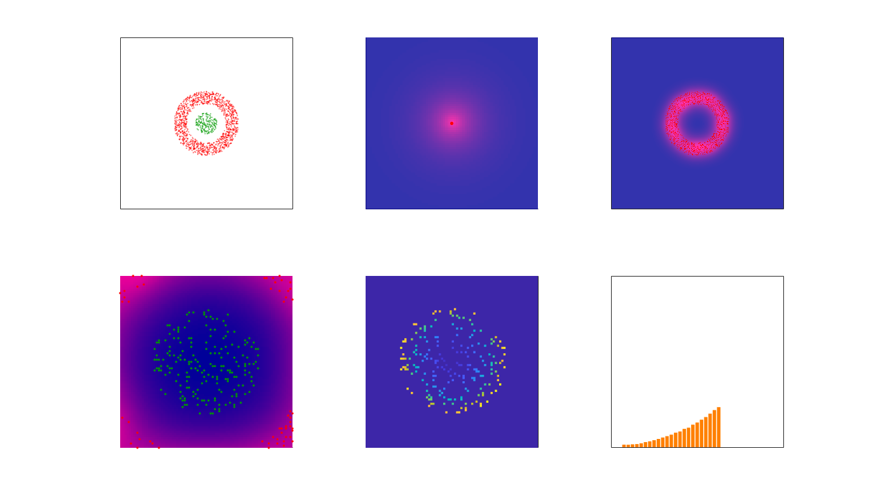
Fig. S7 - Model 3 – TCR phosphorylation (TP) – output data

Slide 4
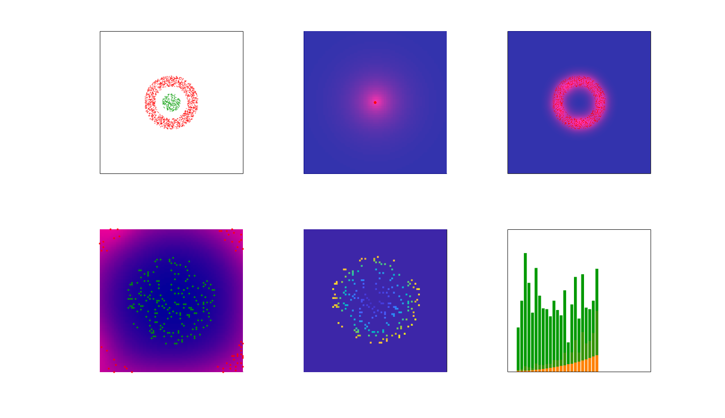
Fig. S7 - Model 3 – TCR phosphorylation (TP) – output data

Slide 5
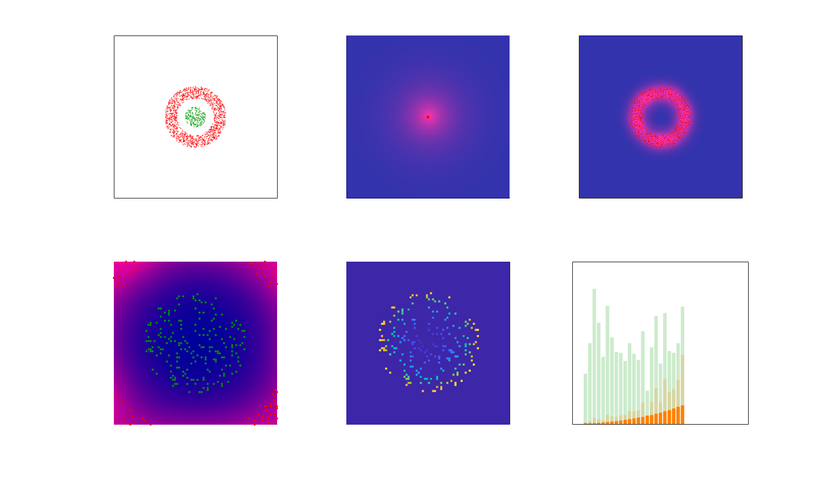

Fig. S7 - Model 3 – TCR phosphorylation (TP) – output data

Slide 6
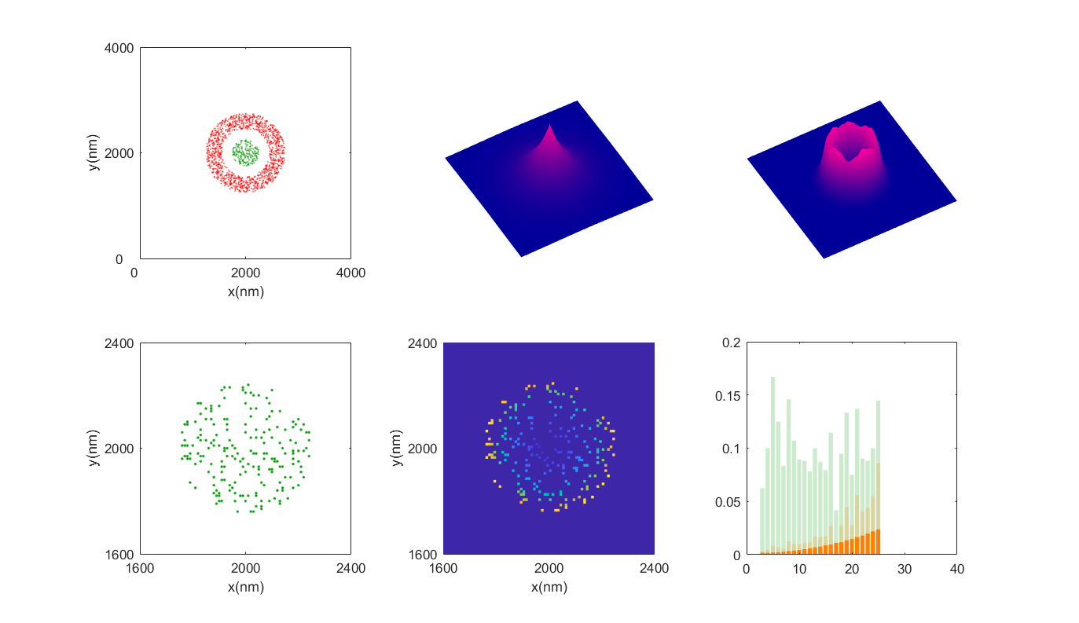
Fig. S7 - Model 3 – TCR phosphorylation (TP) – output data
A
Points pattern
B
One Lck* distribution
C
All Lck* distributions
TCR
CD45
400
4000
y(nm)
400
y(nm)
4000
-400
x(nm)
0
x(nm)
-400
0
-400
D
TCR locations
E
TCR* probability
F
Radial TCR* probability
400

